Slide 1

Smart campus assistant
members of our team：
Zhang Hongwei(202230310224)
Chen Xinyi(202230310223)
Tang Yaqin(202230310227)
Chen Meihan(202230310233)
Rankings are irrelevant

Slide 2
1 Program demonstration & function introduction

Slide 3
Functions and objectives to be accomplished
User-oriented
Scenario recommendation
People flow query
Users can select different scenarios to view real-time people flow scenarios
Tell users during peak hours, low peak hours, and normal periods in different scenarios
Scenario recommendations are made based on the user's own preference selection and traffic analysis
Users can select different scenarios to understand the general changes in the flow of people
Scenario reproduction
People flow forecasting
Notes:
Part 2: Below I will introduce the features of our project according to the requirements, and we use it from the user's perspective and from the development team's perspective when considering the features.
第二部分：下面我将根据需求介绍我们项目的功能，我们在考虑功能的时候，采用了从用户角度和从开发团队角度
First, let's look at the section on user-facing features. The first function is: scene reproduction, users can choose different scenes, of course, these scenes are supported, such as canteens, badminton halls, etc., to view real-time video traffic
首先，请看面向用户功能的部分。第一个功能是：场景再现，用户可以选择不同的场景，当然这些场景是被支持的，例如食堂，羽毛球馆等，去查看实时的视频人流量
The second function is to consider that the video viewing method sometimes requires high network conditions, but the video viewing method can improve the credibility of this product. Therefore, the second function is the direct query of the flow of people, and we will more intuitively display the flow of people in the supported scenarios through data and charts.
第二个功能是：考虑到视频查看方式有时候对网络条件要求较高，但视频查看方式可以提高本产品的可信度。于是第二个功能便是人流量直接查询，我们会通过数据，图表的方式更直观地展现所支持场景的人流量
The third function is: people flow prediction, through the statistics of peak and low peak of the flow of people, obtain universal rules, predict the flow of people in different time periods, and better meet the needs of user convenience.
第三个功能是：人流量预测，通过对人流量高峰和低峰的统计，得到普适规律，对不同时间段的人流量进行预测，更好地满足用户便利的需求
The last function is: scene recommendation, which prioritizes the flow of people in the scenarios frequented by users, and the scenarios with the least current traffic.
最后一个功能是：场景推荐，优先推荐用户常去的场景人流量情况，以及当前人流量最少的几个场景

Slide 4
Functions and objectives to be accomplished
Development-oriented
identify
People flow analysis
Calculate the data
Video
---->
Frame
---->
idengtify human
---->
Algorithm better
Get the data
---->
Data matching
---->
Preliminary processing of data
Enter the model
(include database)
---->
Data interaction calculation
Notes:
Based on user-oriented functions, we have developed development processes and scenarios.
基于面向用户功能，我们制定了开发流程和方案
For the development team, we mainly need to complete the following functional modules: the first module is recognition, reading video--> decomposition of video into --> recognition of human body--> sound recognition algorithm. The second module is people flow analysis: we obtain basic people flow data from the identification module--> match the data with the corresponding scene--> preliminarily screen and process the data. The third module is to calculate the data, based on the model we selected, and the interaction process with the front-end and back-end data, the overall calculation is carried out。
对于开发团队来说，我们主要需要完成下述功能模块：第一个模块是识别，读入视频>视频分解成祯>识别人体>健全识别算法。第二个模块是人流量分析：我们从识别模块获得基本的人流数据>把数据和所对应的场景进行匹配>初步筛选处理数据。第三个模块是计算数据，基于我们所选用的模型，和前后端数据的交互过程，进行整体的计算。

Slide 5

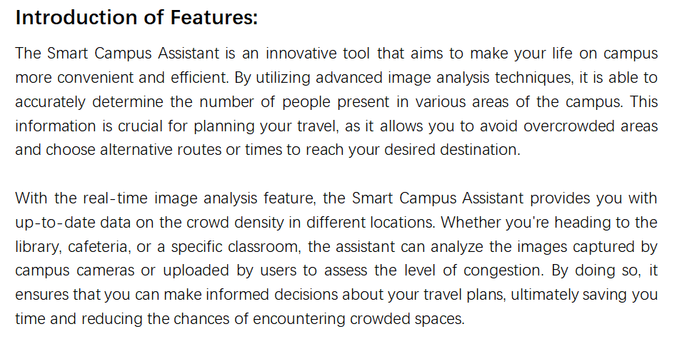
Program description and operation

Slide 6
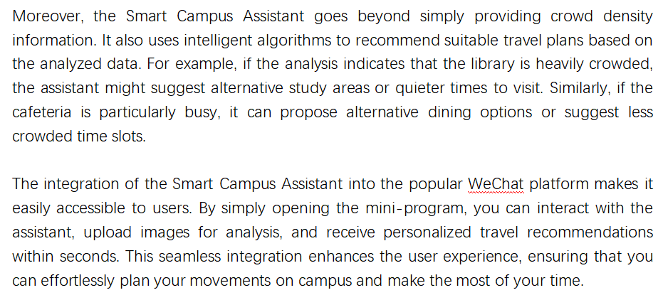
Program description and operation

Slide 7
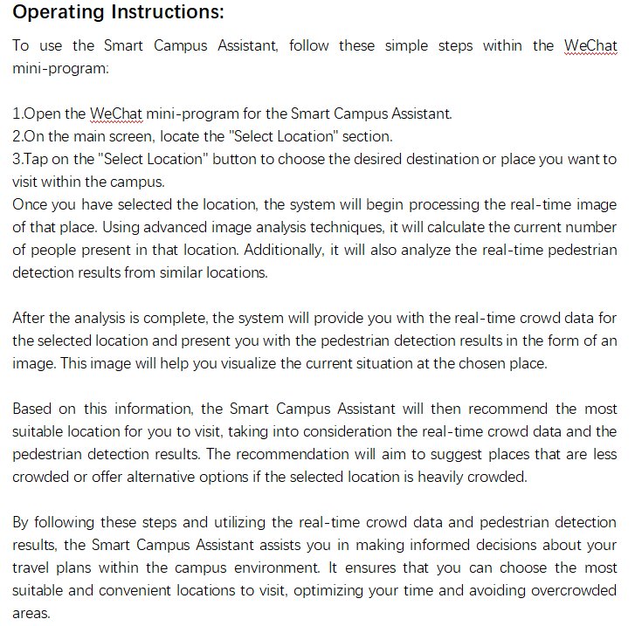
Program description and operation

Slide 8
2 Project process arrangement

Slide 9
Project completion metrics details
The project was iterated twice during the development cycle.
In the control of time, we take the cost of learning into account.
The detail metrics for the completion of the first iteration are:
Name | Details | Time node | Finish or not | Who finished
Front-end learning | Build a concise and user-friendly user interface for the program | 2023/3/30 | Finished | Zhang Hongwei
Algorithmic learning | Use algorithms to identify the flow of people in pictures | 2023/4/8 | Finished | All members
Mini program development learning | The front-end and back-end allow for smooth data interaction | 2023/4/6 | Finished | All members
The first version of the Mini Program development & tests | Basic user interface Main features: Factories display Simple analysis of people flow data Simple scenario recommendation | 2023/4/30 | Finished | All members (Tang tested, others developed)

Slide 10
Project completion metrics details
The main task of the second iteration is
to further make the program run more stable,
and on this basis, optimize the user interface, response time and people flow analysis algorithm
Name | Details | Time node | Finish or not | Who finished
Test check the first version | Find the first version of the vulnerability and give feedback methods | 2023/5/10 | Finished | Tang Yaqin &Chen Xinyi
User interface optimization | Make the user interface more beautiful and convenient, and give optimization instructions | 2023/5/25 | Finished | Chen Meihan
Algorithm optimization design | Optimize the code structure of the algorithm to reduce the time complexity and running time of the algorithm | 2023/5/25 | Finished | Chen Xinyi Chen Meihan
The Second version of the Mini Program development & tests | Better user interface More complete features: Factories display Better analysis of people flow data Better scenario recommendation | 2023/5/30 | Finished | All members (Tang tested, others developed)

Slide 12
Project standards
1.Common functionality:
Rights management(administrators & users)
System functionality indicators:
2.Business functions:
Storage management(background data management)
3.Featured features:
People flow monitoring and analysis
Recommended use of public buildings

Slide 13
Project standards
1.input interface:
input is different public buildings
and show the scenes to users.
System input
interface and reports:
2.repots show:
scenes show to users
people flow show to users
give the reports of recommend

Slide 14
3 Project testing
&
Project risks

Slide 15
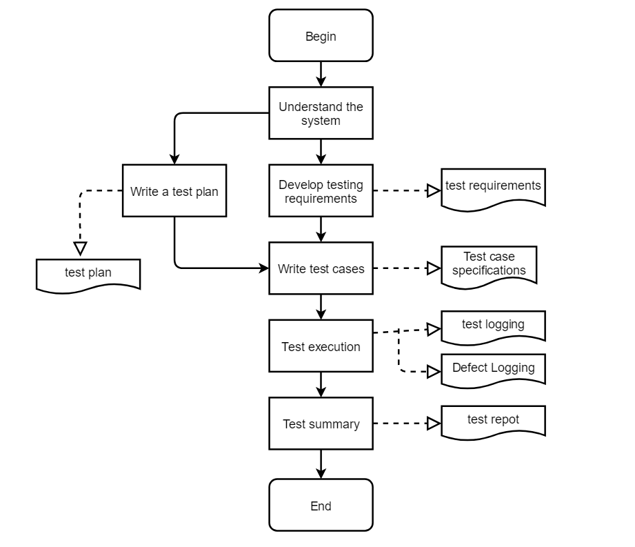
Project testing
Test process flow diagram

Slide 16
Project testing
We divided the entire testing process into the following stages:
Testing phase | Completion Criteria
System training: | Complete training for all systems to be tested in this projectThe tester has used all the systems/modules under test and understood the specific functions of the system under test
Test requirements: | All specific test areas have been identifiedTest requirements have been developedAll test requirements are approved by the customer
Test design: | Test cases have covered all test requirementsThe test case design is complete
Test execution: | All test cases are executedDefects found have defect recordsTest procedures have test records
Analysis of results: | Complete the test analysis report

Slide 17
Project testing
Test function points
Test items | Importance | Passing criteria
Check the number of users | high | Test the accuracy, sensitivity and response speed of the population detection algorithm to ensure that the algorithm can normally detect the number of people information and update the population data in real time.
Data storage and processing | high | Test the stability and reliability of data storage and processing to ensure that population data can be stored and processed accurately and that data can be acquired and updated in real time.
Smart recommendation | In the | Test the accuracy of the intelligent recommendation algorithm and the relevancy of the recommendation results to ensure that the recommended products, activities and services are highly attractive to users.

Slide 18
Project testing
Hardware Test Environment
Software Test Environment
CPU | 12th Gen Intel(R) Core(TM) i5-12500H 2.50GHz
Operating System | Windows 11
Memory | 16GB
Hard drive | 512GB
Video card | NVIDIA GeForceRTX 3060
Software requirements | Purpose
Pycharm | Write back-end code that identifies the number of people algorithm
Wechat developer tools | Design the front-end wechat mini program interface of intelligent campus small assistant

Slide 19
1.2 And specific test cases
Project testing
Test case No | Function points | Preconditions | Performing steps | Expected results | Purpose of the use case | Degree of importance | Execute use case test results
1 | Number of people tested | The user goes to the applet page | Enter the playground test image on an overcast day | The number of people included in the test image should be the same as the number returned by the applet | Test the accuracy of the number recognition algorithm | high | Through
2 | Number of people tested | The user goes to the applet page | Enter the playground test image on an night day | The number of people included in the test image should be the same as the number returned by the applet | Test the accuracy of the number recognition algorithm | high | Through

Slide 20
1.2 And specific test cases
Project testing
Test case No | Function points | Preconditions | Performing steps | Expected results | Purpose of the use case | Degree of importance | Execute use case test results
3 | Smart Recommendations | The user goes to the applet page | Click on [recommendations] to view recommendations | Return the venue with the most historical foot traffic in the recommendation | Test whether the applet can recommend people to their favorite places based on historical data | medium | Don't pass
two number of people cases
two smart recommendations cases

Slide 21
Project risk
01
Natural risks
Illness, holidays, exams, school events, group meetings
02
Behavioral risk
Intra-group relationships, personal emotions, stress, need for rest
03
Duration risk
The construction period is delayed and the construction period is not completed
04
Technical risks
When encountering problems that will not be met, you need to learn in time and are not skilled
05
Organizational risk
Meetings are not timely, communication is not in place, and understanding is problematic
06
Quality risk
The user interface is not user-friendly. The algorithm is not efficient. The recommendation function is not smooth. The test is not comprehensive enough

Slide 22
Project Risk
 | Strength |  |  | Weakness
 | Easy to enter data acquisition | Embedded algorithm blocks | Encapsulated user interface | The user interface isnot pleasing | The scenarios are not diverse enough
Opportunity | Video data is diversified, and framing efficiency is improved | Easy to change algorithms for different effects | Easy to design and handle user interface modules | The interface can be optimized based on user feedback or member self-testing | As the software becomes more stable, different scenarios and functions can be added
Threat | Select or convert to supported data input formats (video, images) whenever possible | Choose the most efficient and stable algorithm possible | Adjust the interface as much as possible to make it user-friendly | It may directly lead to a decline in user experience and affect the market of software | Lack of interactivity and choice
We also use SWOT analysis for project quality risk identification.

Slide 23
Project Risk
Risk responses are as followed for apart:
Risks | Probability | effect | sort
The user interface is not user-friendly. | 50% | 3 | 3
The algorithm is not efficient. | 50% | 4 | 1
The recommendation function is not smooth. | 40% | 4 | 2
The test is not comprehensive enough | 30% | 3 | 4

Slide 24
Thank you

